Slide 1
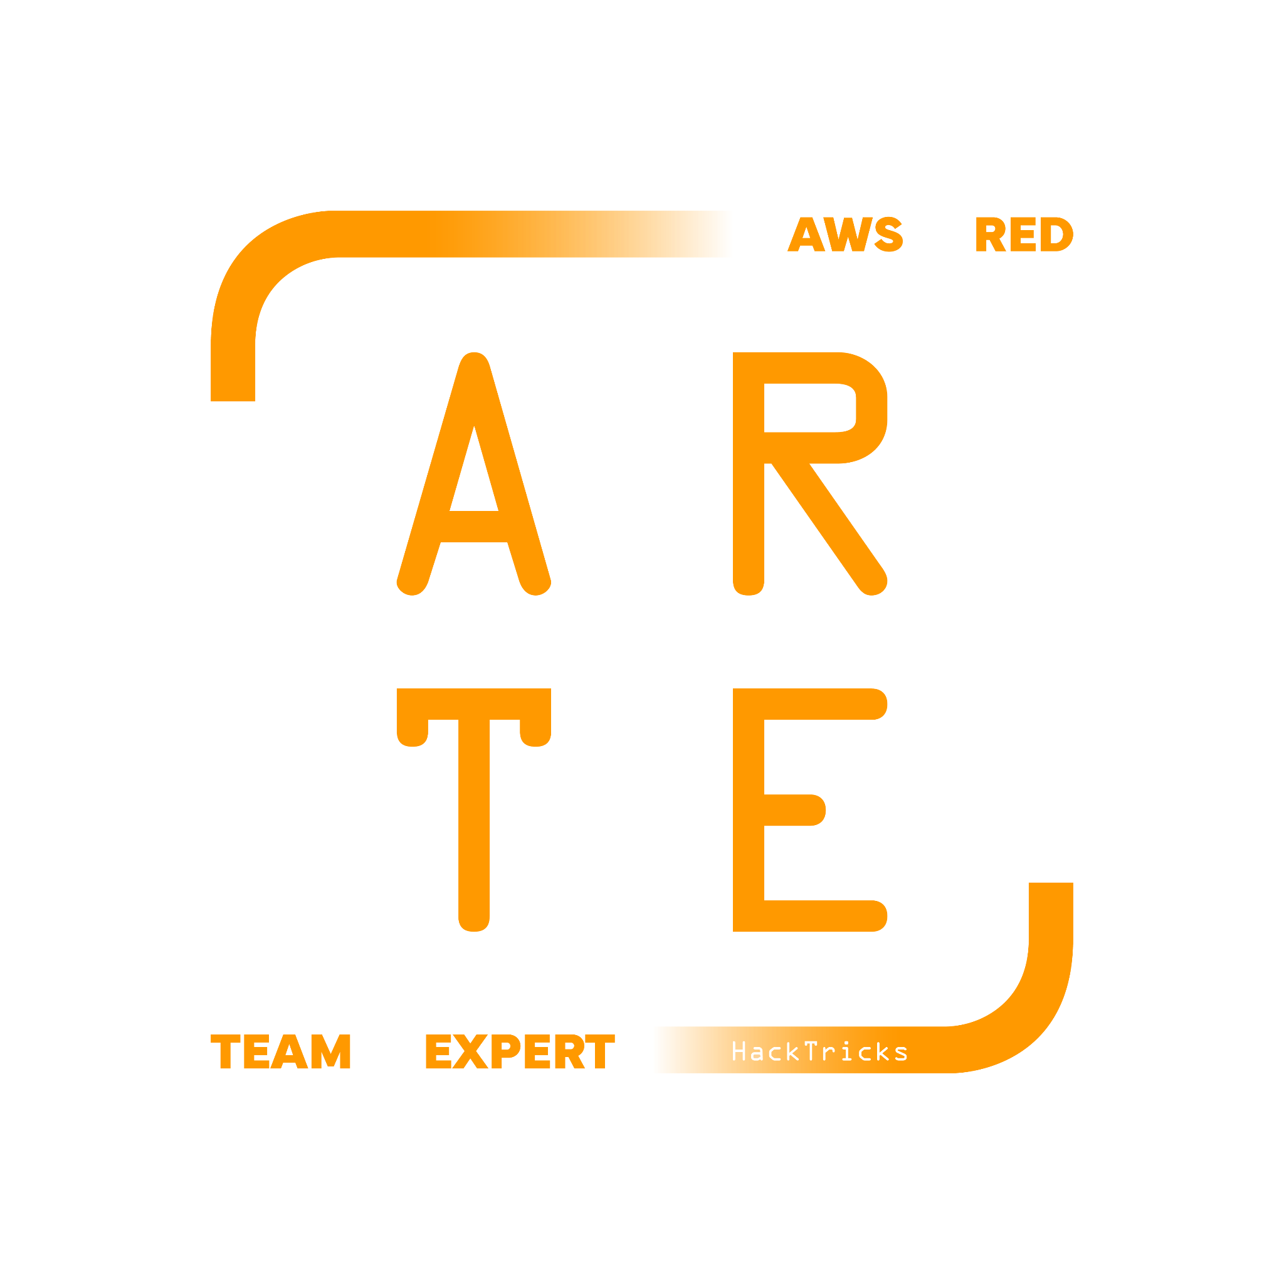
Lightsail
HackTricks Training
https://t.me/CyberFreeCourses

Slide 2
Basic Information
In the early days AWS was equivalent to EC2… I suppose.
AWS started creating other services while EC2 size increased.
EC2 became to be too big, too many settings, too many configuration options, too many features… Just try to learn how EC2 auto-scaling work from 0 knowledge (It took me 1 week).
Because EC2 is too complicated, instead of making it simpler*… AWS released Lightsail (It’s like EC2 + ECS + Route53 + S3 + RDS with minimal features of each service).
*Actually, they try to make it easier to understand, but I guess it’s a work in progress yet
https://t.me/CyberFreeCourses
https://cloud.hacktricks.xyz/pentesting-cloud/aws-pentesting/aws-services/aws-lightsail-enum

Slide 3
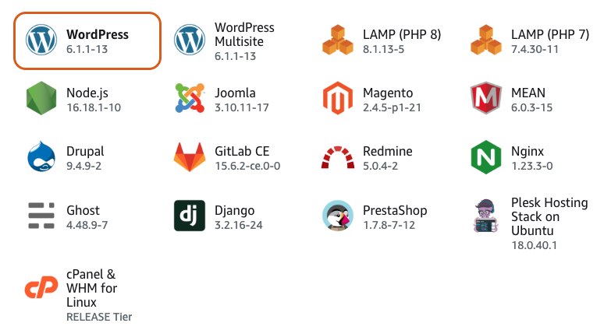
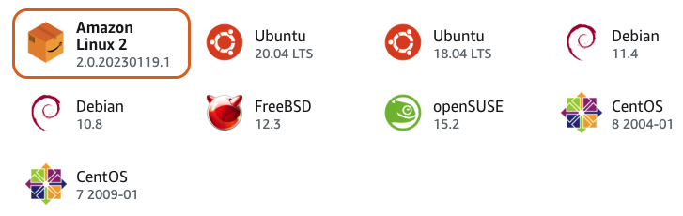

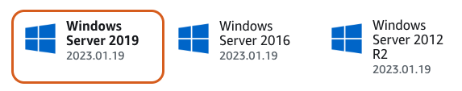
Offered Instances
If you see a WordPress in an AWS IP, it’s highly probable running in Lightsail.
https://t.me/CyberFreeCourses
https://cloud.hacktricks.xyz/pentesting-cloud/aws-pentesting/aws-services/aws-lightsail-enum

Slide 4
Metadata
Lightsail doesn’t support IAM roles or Instance Profiles. However, an IAM role is accessible from the metadata endpoint.
Lightsail machines also doesn’t run in your account, but in an account that belongs to AWS, so
Lightsail IAM role actually belongs to an AWS account.
https://t.me/CyberFreeCourses
https://cloud.hacktricks.xyz/pentesting-cloud/aws-pentesting/aws-services/aws-lightsail-enum
Notes:
Create Lightsail instance, get ssh access and show: aws sts get-caller-identity using the metadatas credentials

Slide 5
Manual Enumeration
# Instances
aws lightsail get-instances #Get all
aws lightsail get-instance-port-states --instance-name <instance_name> #Get open ports
# Databases
aws lightsail get-relational-databases
aws lightsail get-relational-database-snapshots
aws lightsail get-relational-database-parameters
# Disk & snapshots
aws lightsail get-instance-snapshots
aws lightsail get-disk-snapshots
aws lightsail get-disks
# More
aws lightsail get-load-balancers
aws lightsail get-static-ips
aws lightsail get-key-pairs
https://t.me/CyberFreeCourses
https://cloud.hacktricks.xyz/pentesting-cloud/aws-pentesting/aws-services/aws-lightsail-enum

Slide 6
Privilege Escalation
Because of the lack of IAM Roles in Lightsail you won’t be able to directly escalate privileges in Lightsail, but you will be able to access potential sensitive information that you might be able to use to escalate privileges:
lightsail:DownloadDefaultKeyPair
Access to instance via SSH
lightsail:GetInstanceAccessDetails
Access to instance via SSH
lightsail:CreateBucketAccessKey
Access Bucket
lightsail:GetRelationalDatabaseMasterUserPassword
Access Database
lightsail:UpdateDomainEntry
Create DNS entries
For more information check https://cloud.hacktricks.xyz/pentesting-cloud/aws-pentesting/aws-privilege-escalation/aws-lightsail-privesc
https://t.me/CyberFreeCourses

Slide 7
Post Exploitation
You could check for extra information in DB & Instance snapshots
Most privilege escalation techniques are about how to access more sensitive information, check them for potential post exploitation tricks
For more information check https://cloud.hacktricks.xyz/pentesting-cloud/aws-pentesting/aws-post-exploitation/aws-lightsail-post-exploitation
https://t.me/CyberFreeCourses

Slide 8
Persistence
Persistence in running instances/containers
DNS persistence
For more information check https://cloud.hacktricks.xyz/pentesting-cloud/aws-pentesting/aws-persistence/aws-lightsail-persistence
https://t.me/CyberFreeCourses

